Slide 1


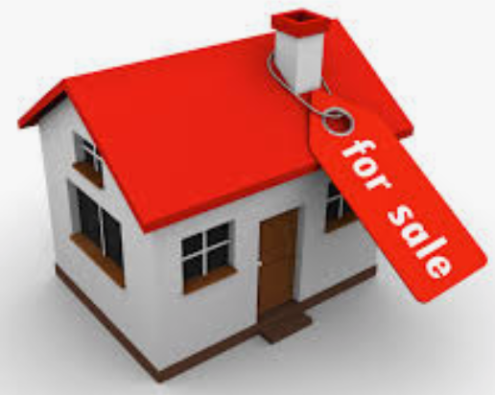
By: Sergio Insuasti Chavez
Capstone
Predict Property Valuations
a Client Project

Slide 2

Project Introduction
Company Overview: Sellable takes the hassle out of selling your home, they’re property experts that buy homes, make them look spectacular, and sell it using the best agents in the business. Currently receiving valuation requests of over 200 properties a month.
Objectives:
To have an automated valuation model to accurately predict property valuations.
Key Requirements:
Data clean customer .cvs file
Obtain satellite imagery and calculate square lot area and built area
Scrape valid information from Web Sites that would be used for the model

Slide 3





Action Plan
Data Gathering and Resources
CSV Flat Files
Customer File
Id, Street Address, Suburb, Postcode, Latitude, Longitude, Lot size
Street Suffix Abbreviation
Long Suffix, Commonly, Abbreviated
WEB Scrapping Sites
Number of Bedrooms, Bathrooms, Garages, Lot size, Valuation,
Sold Dates, Type of Sales, Sold Amounts, Photo Link, House Information
Valuation
Valuation

Slide 4


Action Plan cont.
WEB Scrapping Sites cont.
+
Government sites
Planning Information
Satellite Image
Calculate Lot size using Opencv and numpy
Features Used
longitude, latitude , address, suburb, , postcode, state,
No. of Bedrooms, No. of bathrooms, No. of garages,
Lot size(given), Lot size(calculated), Lot size(scraped),
Valuations (scrapped)

Slide 5
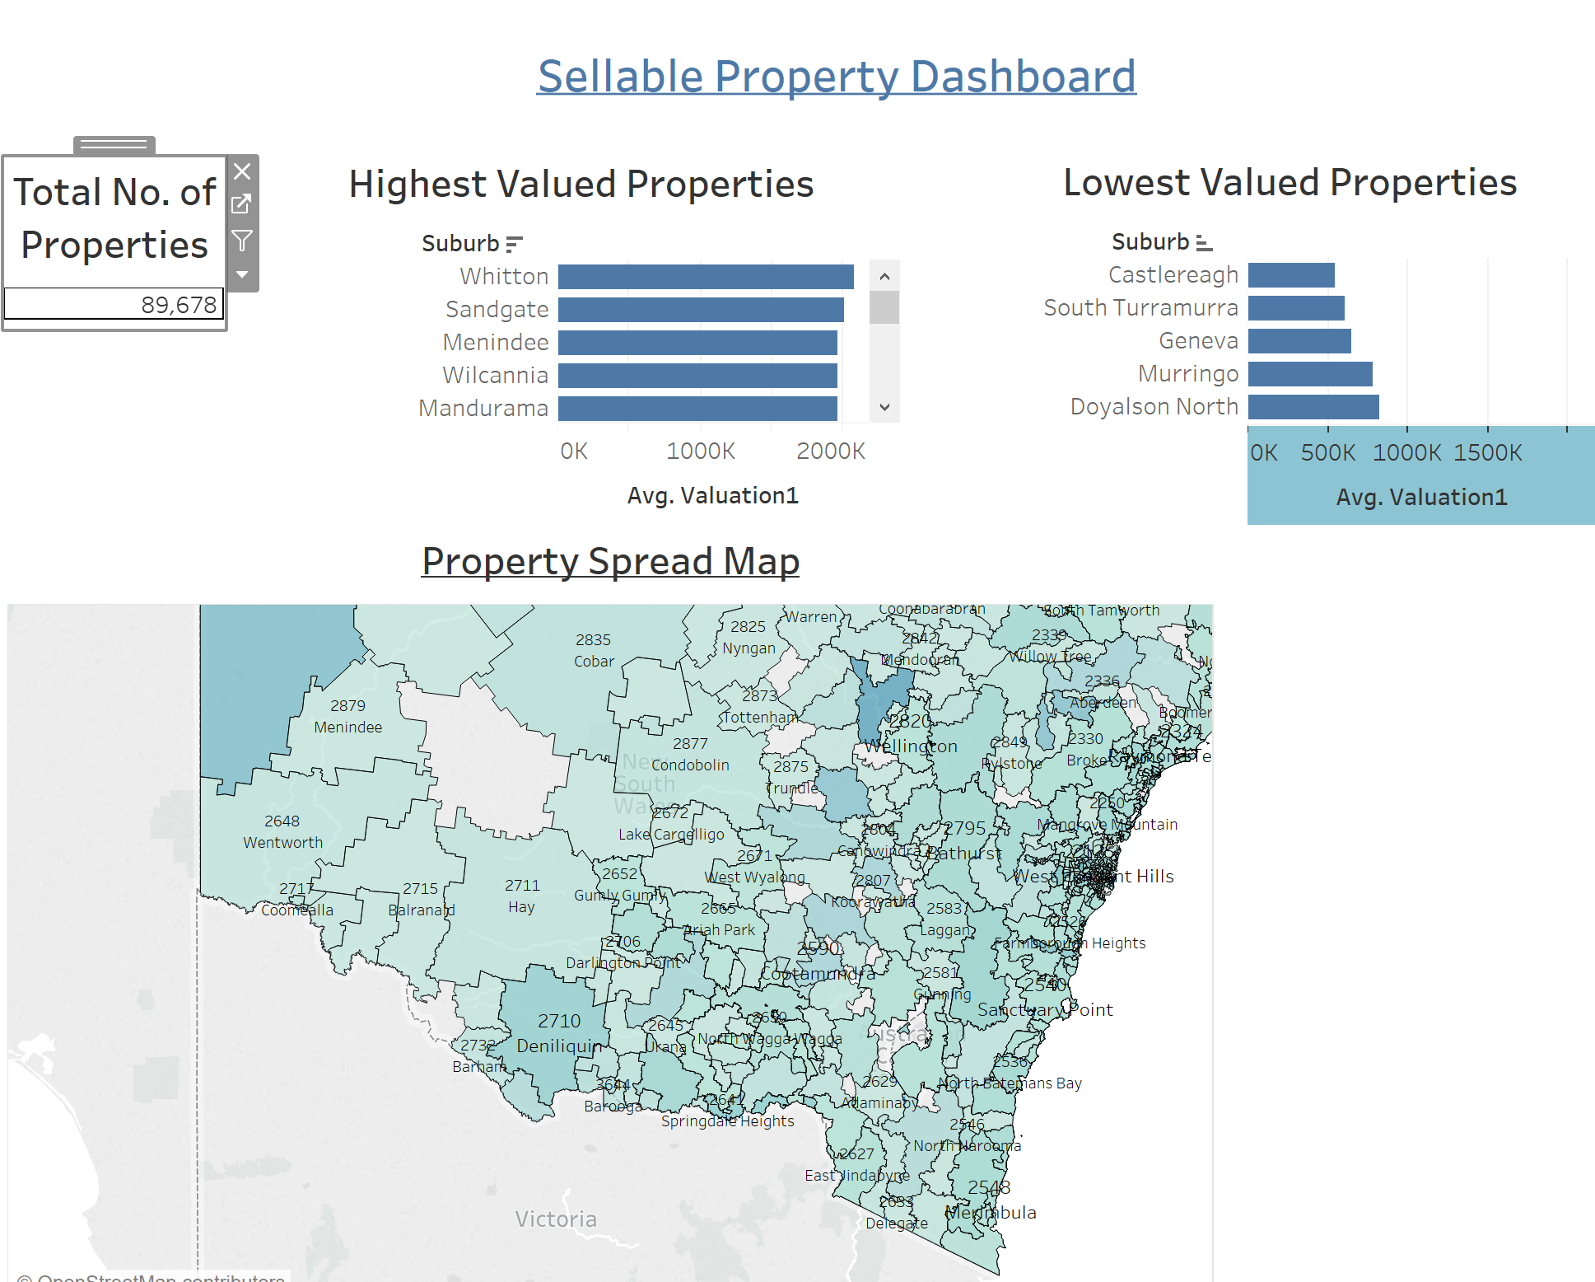
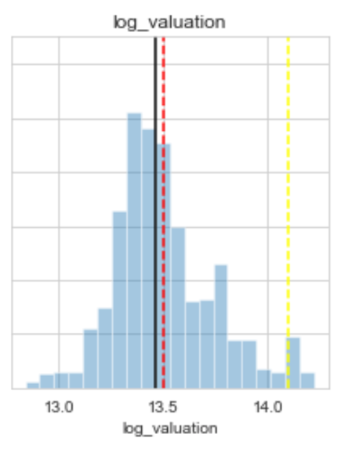
Exploratory Data Analysis

Slide 6
Valuation Model
The property Prediction was based on various features listed previously
Regression Models used are
Lasso(L1) – Helps in reducing over fitting by been aggressive with feature selection, this is in order to enhance the prediction accuracy. It adds a penalty equivalent to the absolute value of coefficients
Rigde(L2) – Where predictor features are highly correlated, it adds a penalty equivalent to the square of the coefficients
RandomForest – An example of an ensemble method, meaning it relies on the aggregating the results of an ensemble of simpler estimators.

Slide 7
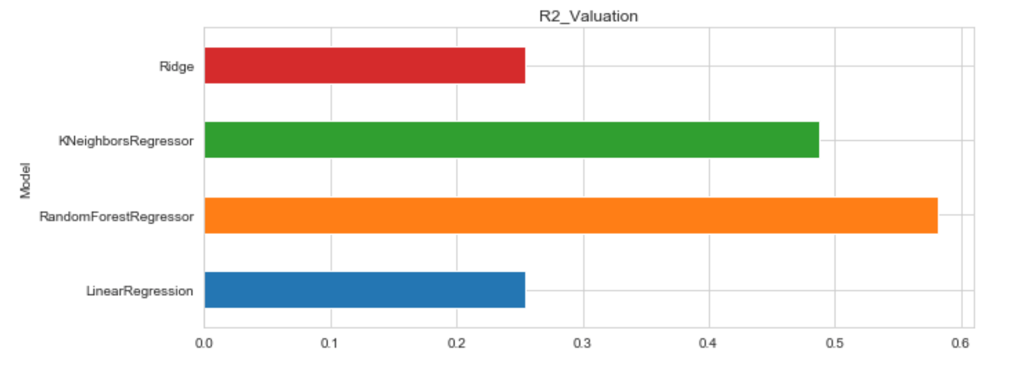
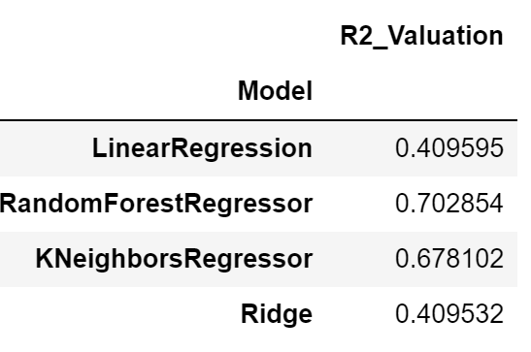
Model Selection Choice
Regression Models Results

Slide 8
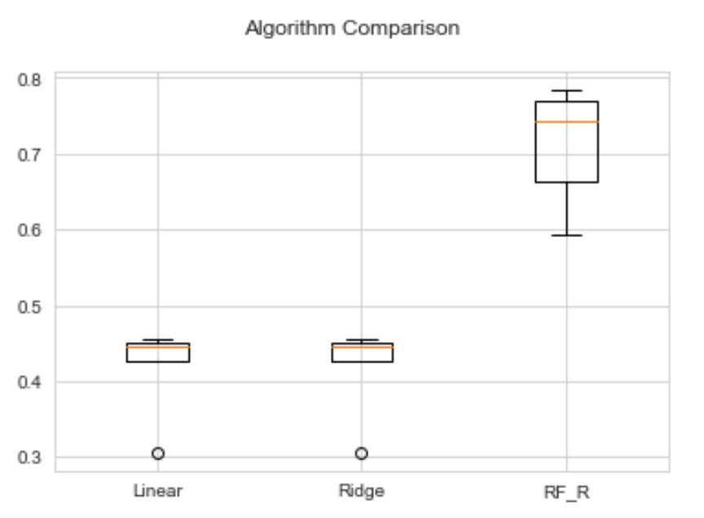
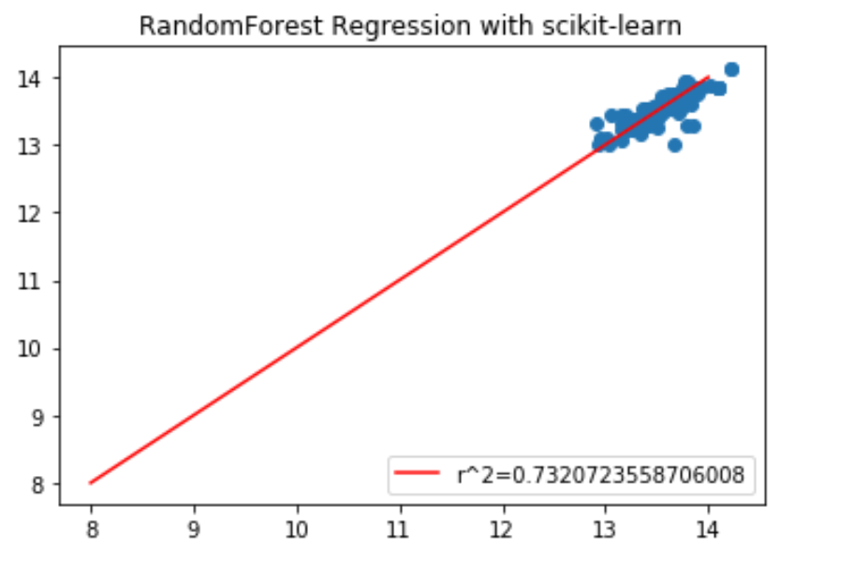
Model Result Output
Linear: 0.357124 (0.112477)
Ridge: 0.359710 (0.112818)
RF_R: 0.604657 (0.080676)

Slide 9
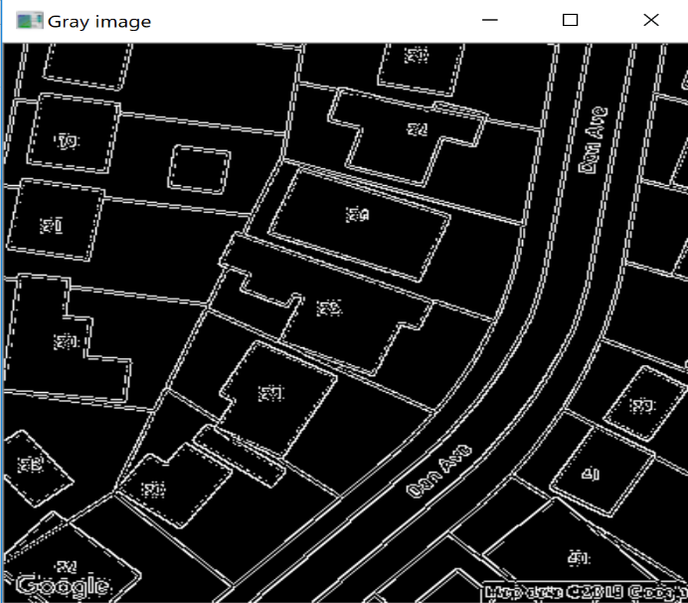
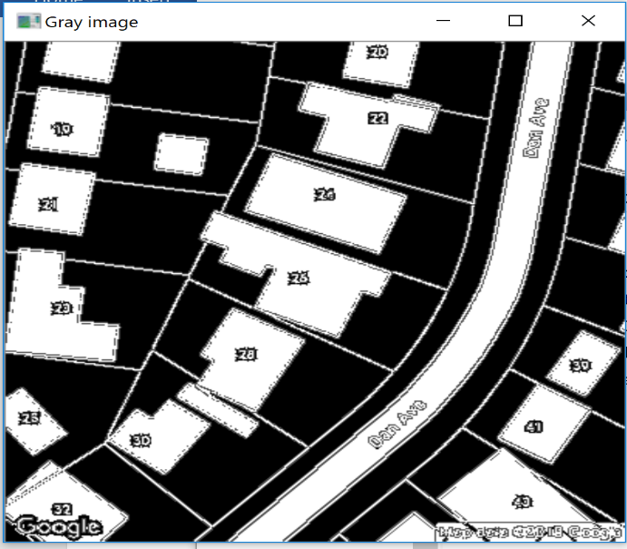
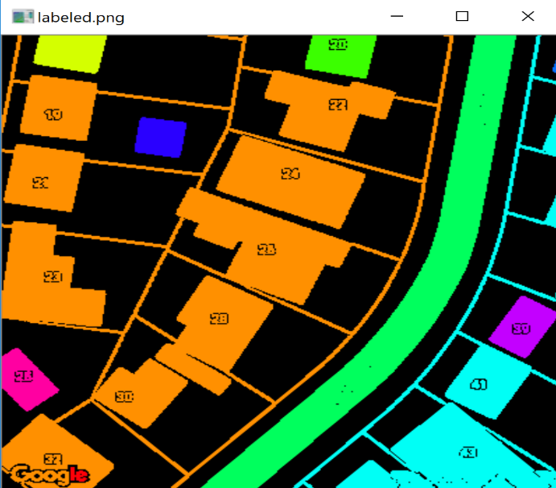
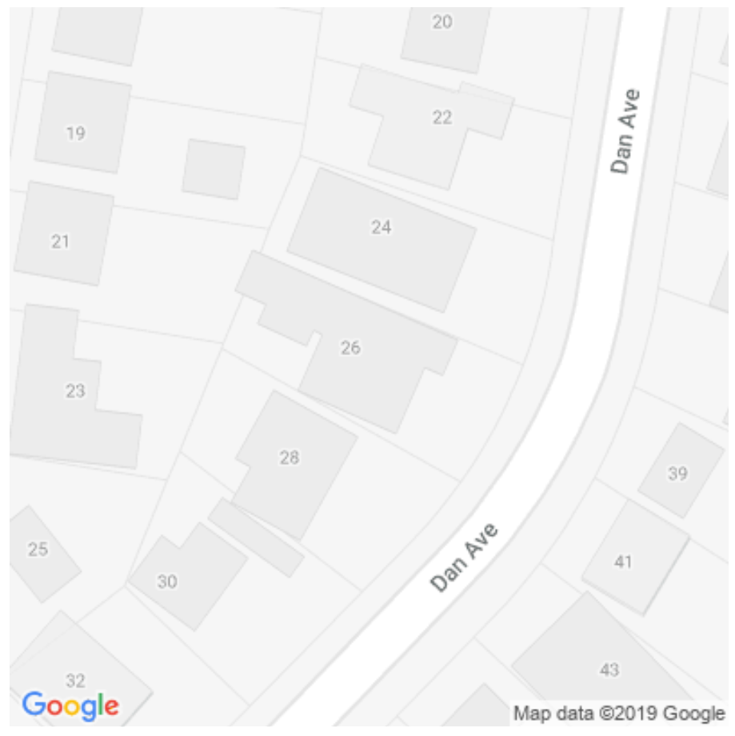
Image Recognition
Start with the address longitude/Latitude and feed this to google maps using an API key obtained
Grab the Google Image data and save the image files 400x400
Display the grayscale image
Mask based grayscale colour of the built up area
Label and show the connected components in the mask
Label the regions and find which label contains the centroid.
Calculate the Lot Size meters_ppx=156543.03392*Math.cos(data.latitude[0]*Math.pi/180)/Math.pow(2,zoom)

Slide 10
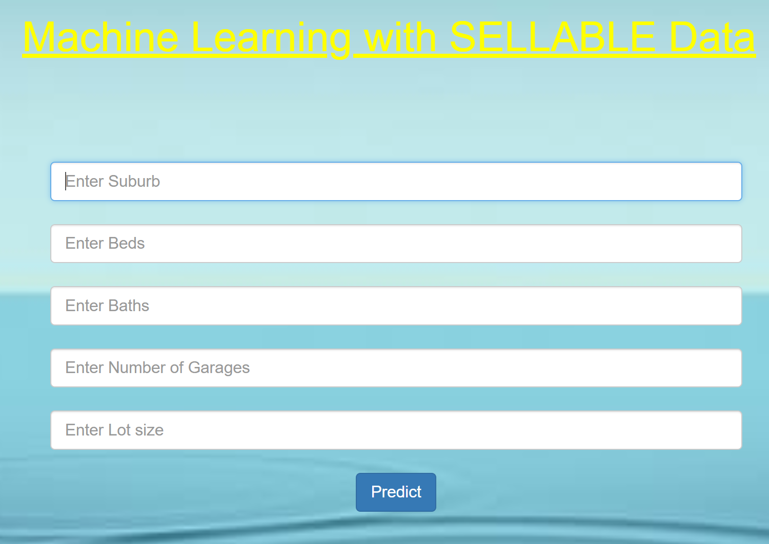
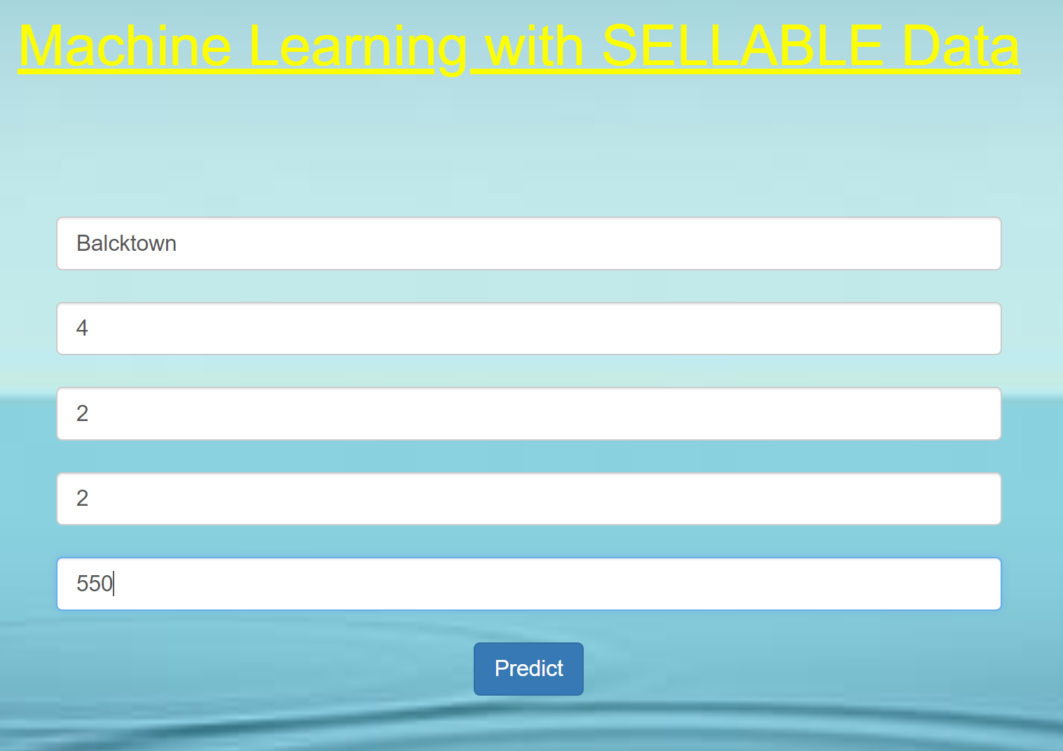

App Demo
Predicted Valuation $750,656

Slide 11
Questions
THE END

